Slide 1
Using CoppeliaSim to speed up software development for a physical robot
By Christian M. Netter
DPRG Monthly meeting – 10/10/2020
https://github.com/nettercm/simple_3pi_simulation (this presentation is here...)
https://github.com/nettercm/trinity
https://www.youtube.com/playlist?list=PLKz57Za9efT8gHFnLunfcnyxTgr257nPJ

Slide 2
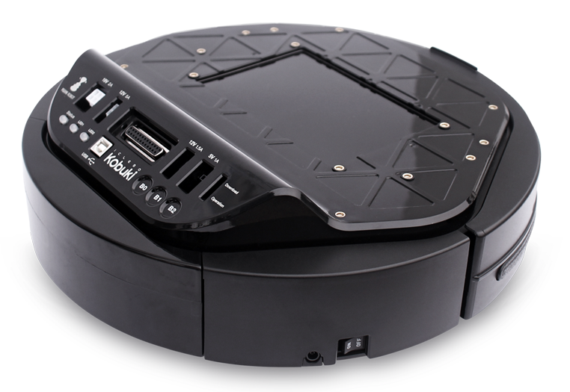
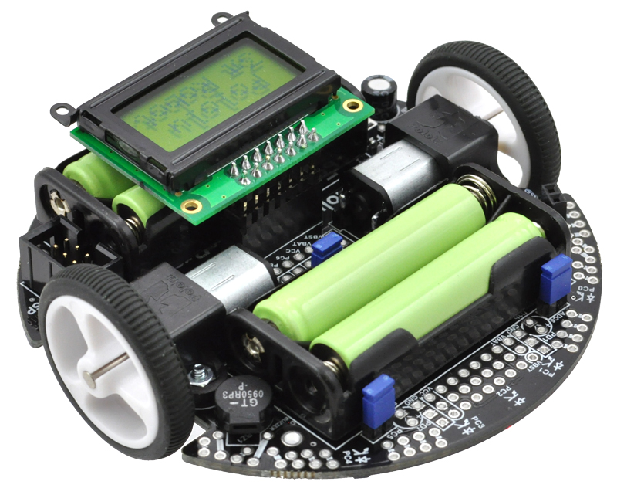
Things I have experience with:
Atmel AVR, STM32
Raspberry Pi, Beaglebone Black
2 wheel differential drive
OpenCV (but it’s been a while)
IR, Ultrasonic, Lidar
Some ROS
Simulation
Things I have not tried, real or simulated, or very little:
Large robots; Outdoor robots
GPS; IMU
Tracked robots
Meccanum wheels
Manipulators
Self-balancing
If you have a “but what about X?” question, I’ll have to wing it if
the topic is one from the list above.

Slide 3
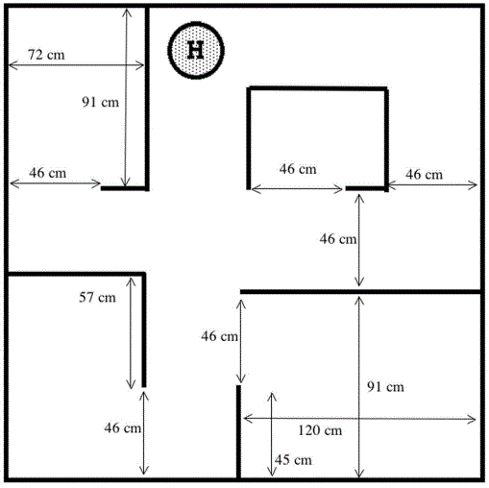
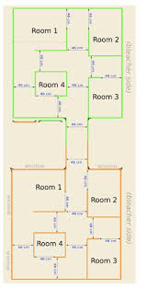

The primary use case (for me)
How can I work the kinks out more efficiently?
How can I spend less time chasing the robot and more time improving the logic?

Slide 4
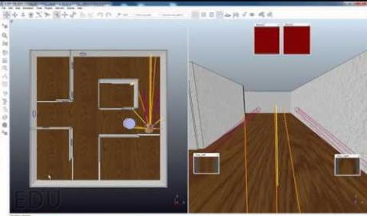
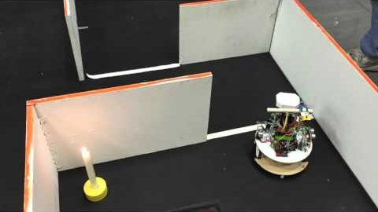
The end result
A simulated robot
A simulated arena
One set of source code that runs on the real robot (Pololu Orangutan SVP with atmega1280 MCU) and the simulated one

Slide 5
Why am I presenting this to you?
At the end of this presentation you can hopefully answer the following questions for yourself:
What does this even mean?
Does this make sense for the types of robots I’m building?
Can this tool and or/the general approach speed up my own development?
Is this something I can figure out?
Hint: I’m trying to convince you that the right answer is “Yes”

Slide 6
In what situations does Simulation help?
A very incomplete list
When you want to organize a robot contest in the middle of a pandemic!
When you want far away participants in your contest
When working in a team that has only one physical robot
When you want to experiment with new algorithms and concepts under ideal conditions, so that sensor and actuator uncertainty does not add confusion
When you want to try an additional or different sensor, or just a different sensor position/angle w/out modifying robot just yet
When the full contest "arena" does not fit into room where programming is comfortable
When you want to thoroughly test your code without having to chase after your actual robot all the time.
When you want to check how robust the logic is (e.g. by deliberately adding sensor noise or reducing sensor accuracy)
That said….all models are wrong, some are useful....simulation is a tool.

Slide 7
When is it less practical?
A very incomplete list
Don't expect the following to be easy or practical:
Tune PID gains associated with low-level motor control
Fine-tune any thresholds associated with sensor readings
Tune PID gains on a self-balancing robot

Slide 8
So how is this different from the DPRG LFS?
3D
  Very, very basic modeling
  Decent rendering
General purpose
Physics-based
  Rigid body dynamics
  Collisions, gravity, mass, inertia
Think of it as a game engine and level editor, but geared towards robotics use cases

Slide 9

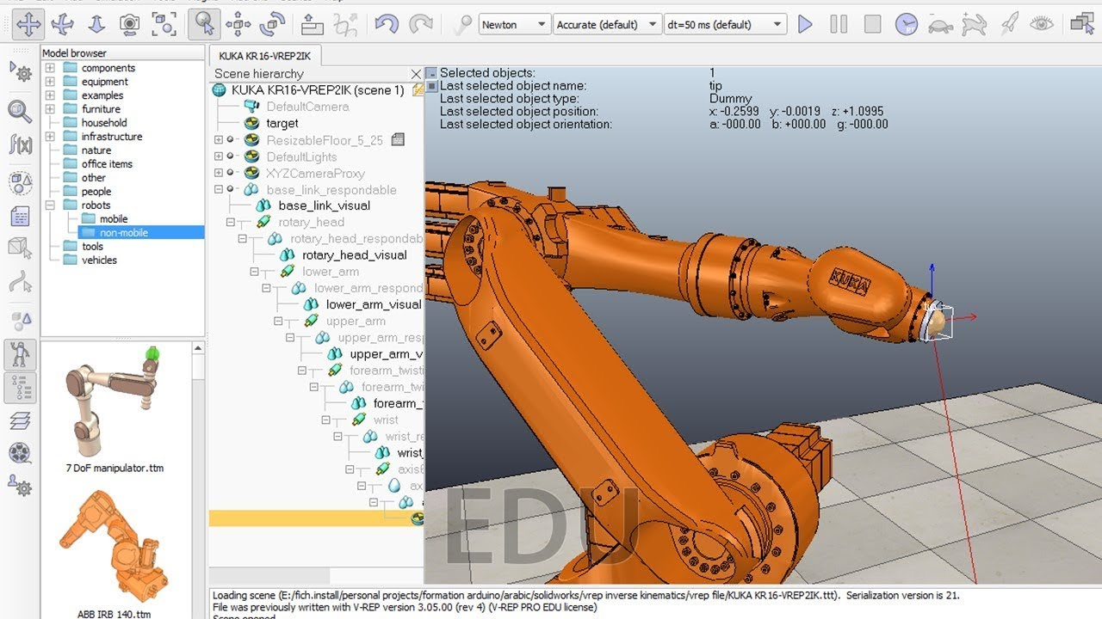
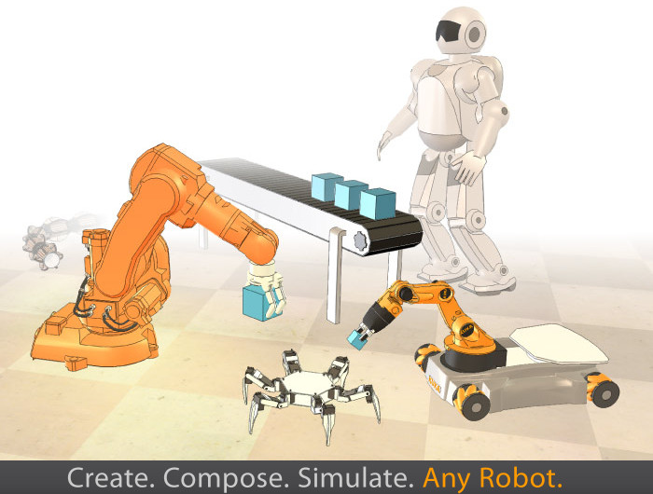
Why CoppeliaSim? It’s the easiest one to use!
https://www.youtube.com/user/VirtualRobotPlatform
https://www.youtube.com/c/LeopoldoArmesto/videos

Slide 10

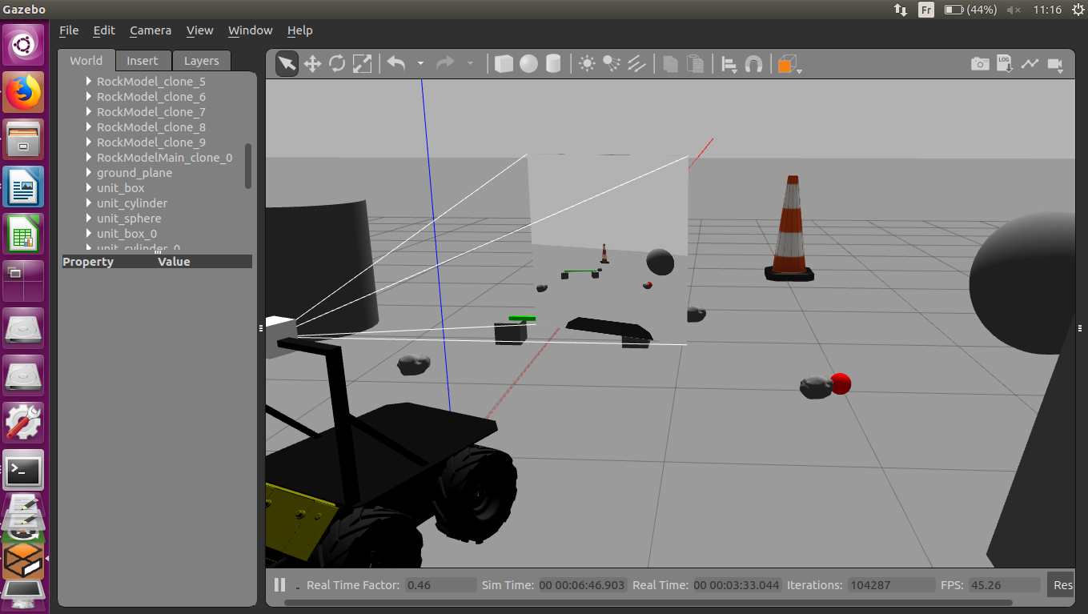
Why not Gazebo? Harder to use, but best for ROS

Slide 11

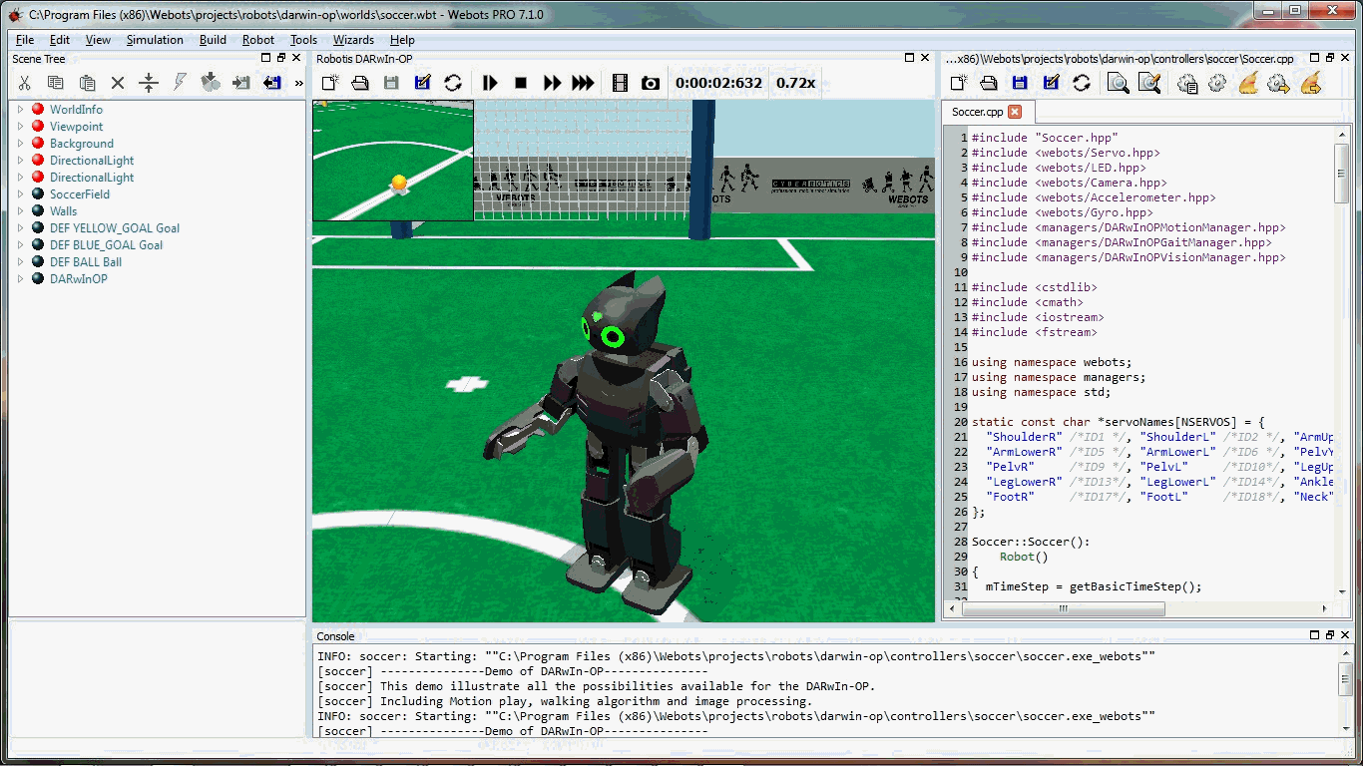
What about WeBots? Yes it does look promising….

Slide 12
Any questions before we dig deeper?

Slide 13
What do you need to learn to do this?
How to use the simulator
How to correctly structure your code
How to interface your code with the simulator
How to calibrate things (including your expectations!)

Slide 14
How to use the simulator

Slide 15
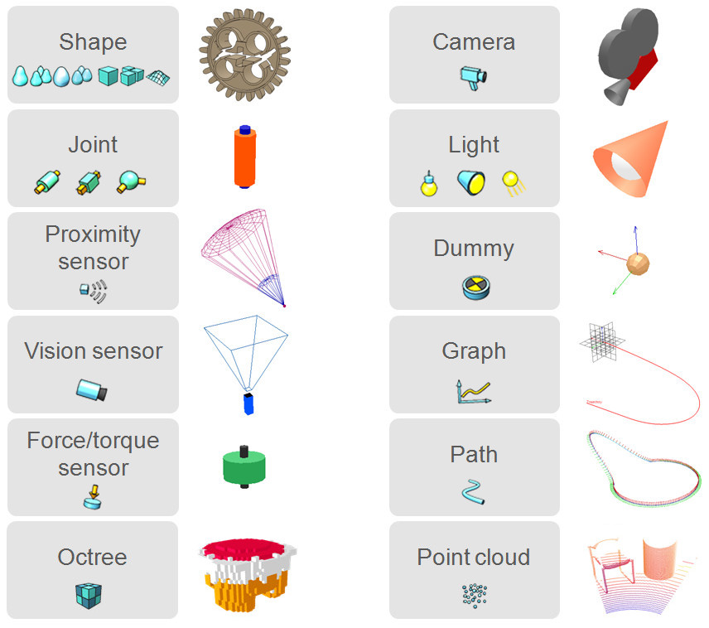
How can a create the simulated robot?
…by putting it together from the available building blocks

Slide 16
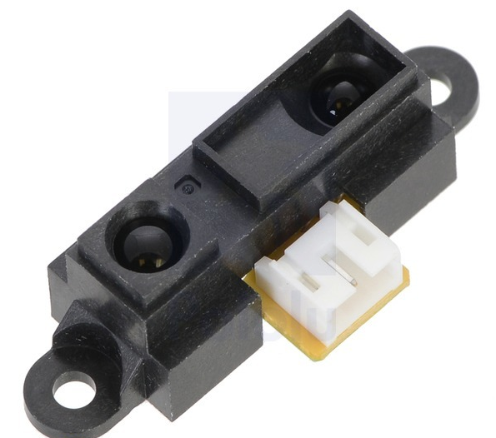

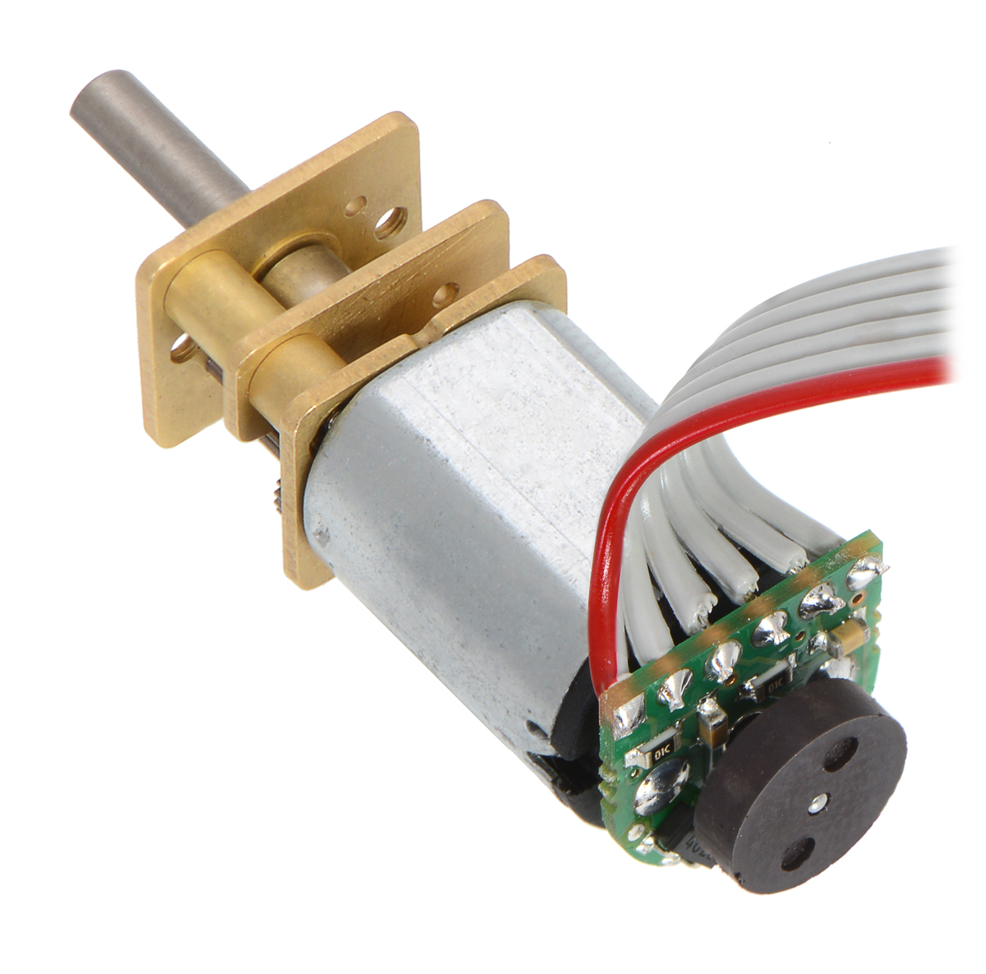

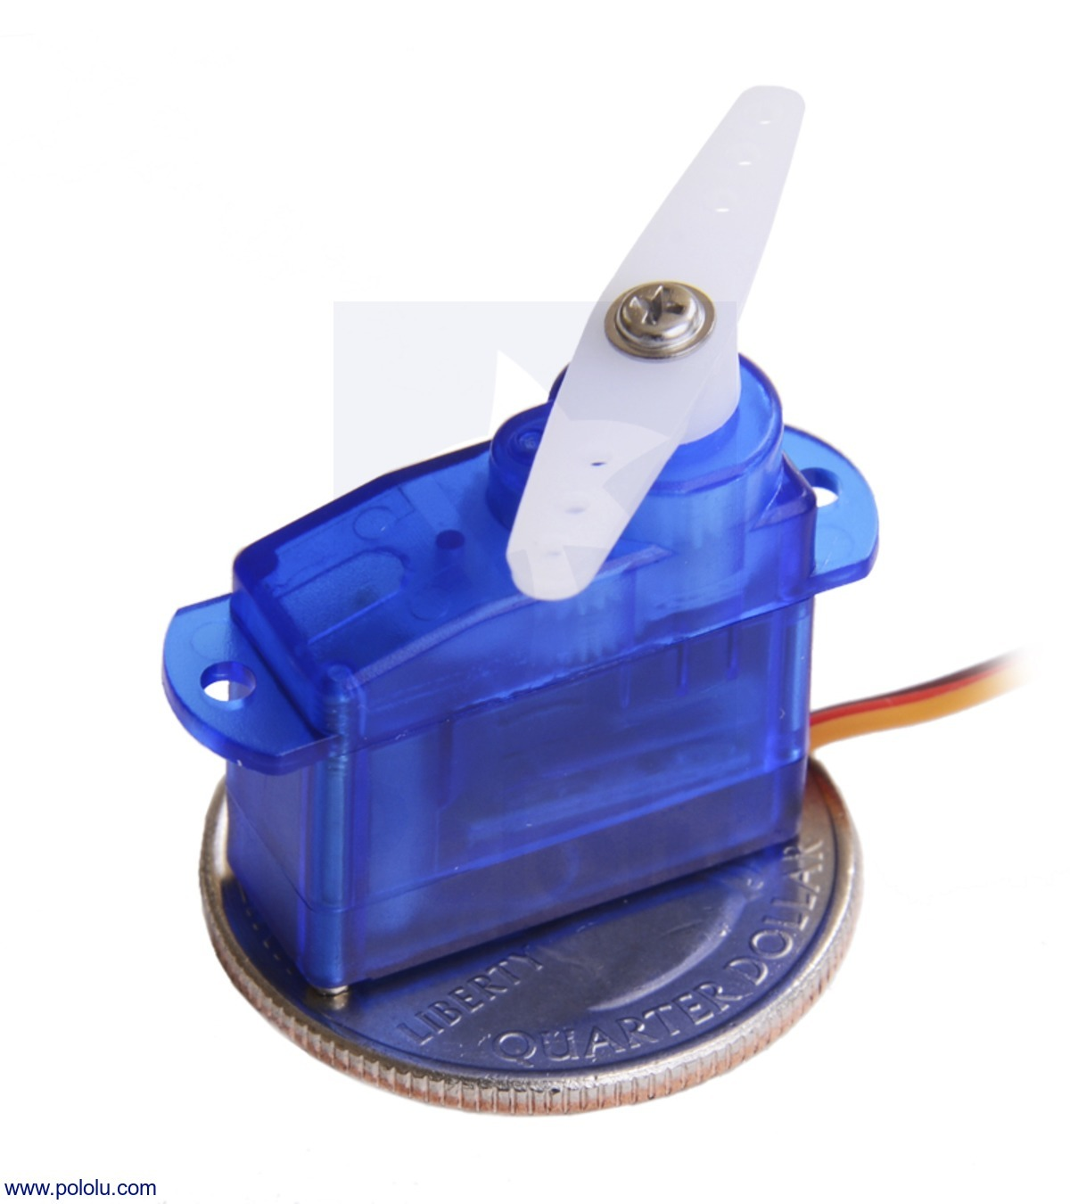
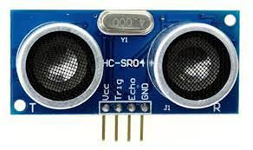
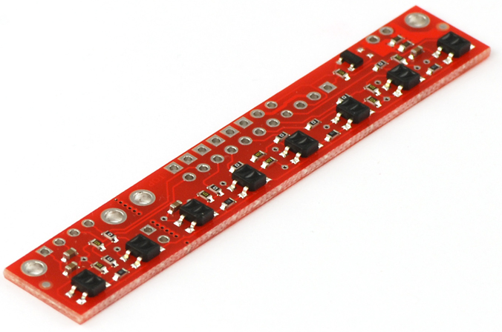


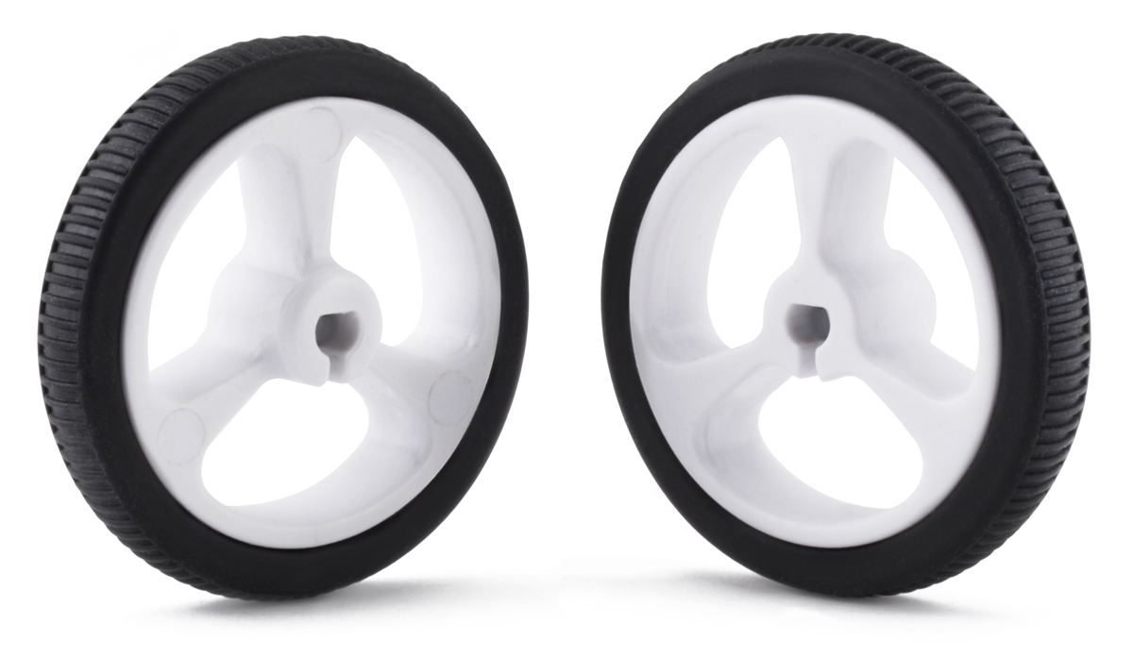
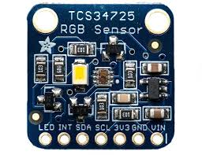
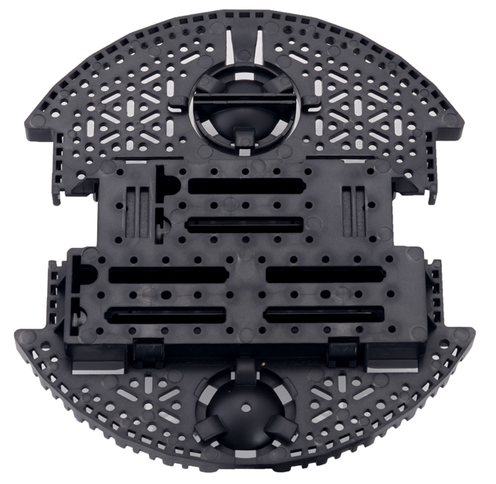
Examples….
8 x

Slide 17
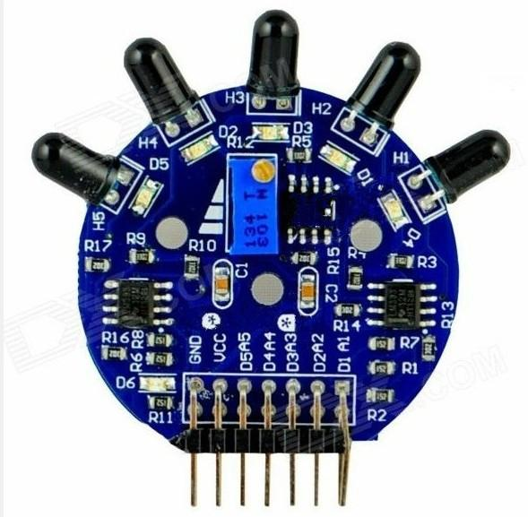
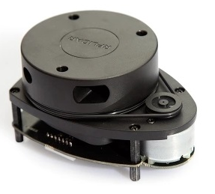


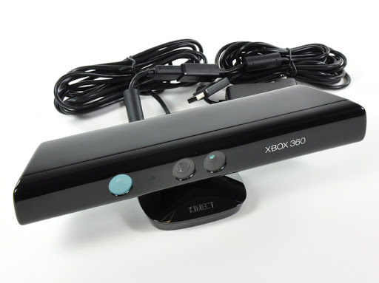
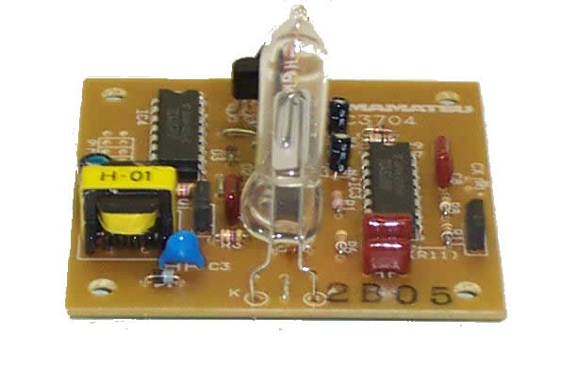
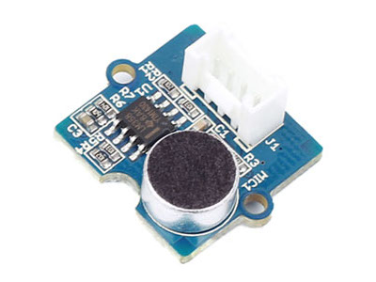
5 x
+
+ special logic
+ special logic
Use depth image
N/A

Slide 18
OCR0A = 0x80 //50% PWM duty cycle

Slide 19
set_motors(128,128)
OCR0A = 0x80 //50% PWM duty cycle
Gear Motors, Servo Motors, Sensors, Camera

Slide 20
What do you need to learn to do this?
How to use the simulator
How to correctly structure your code
How to interface your code with the simulator
How to calibrate things (including your expectations!)

Slide 21
Clearly separate source code that deals with hardware and I/O, from source code that implements the logic (structural aspect)
Don't do I/O from within the logic; instead do: 1) read inputs 2) run logic, 3) write outputs
Make sure logic code is portable (especially if actual robot uses microcontroller
Avoid preemptive multitasking in the logic - prefer cooperative tasking and/or state machines
Avoid directly using APIs that use "actual time" / "wall clock time" (mainly an issue if controller is Linux based or Python based). Time advances by a very specific amount every iteration through the main loop

Slide 22



GENERAL Workflow
Create robot base using one or more primitive shapes (e.g. cylinder)
Add one joint for each drive motor. Make child of base.
Add cylinder for each wheel. Make child of joint.
Add sphere or cylinder for each caster. Attach to base via force sensor.

